Slide 1

Visualize Data with Python Capstone Project
OPTION 2: VISUALIZING THE NETFLIX STOCK PROFILE

Slide 2
Visualizations
All visualizations were created with Matplotlib, Pandas and Seaborn.
The author of the presentation is responsible for the visualizations and the accompanying observations.
How Were Netflix Quarterly Stock Prices Distributed In 2017?
How Did Earning Per Share Estimates Compare to Actuals?
How Does Revenue and Earnings Performance Compare by Quarter?
How Did Netflix Compare to the Dow Jones?

Slide 3
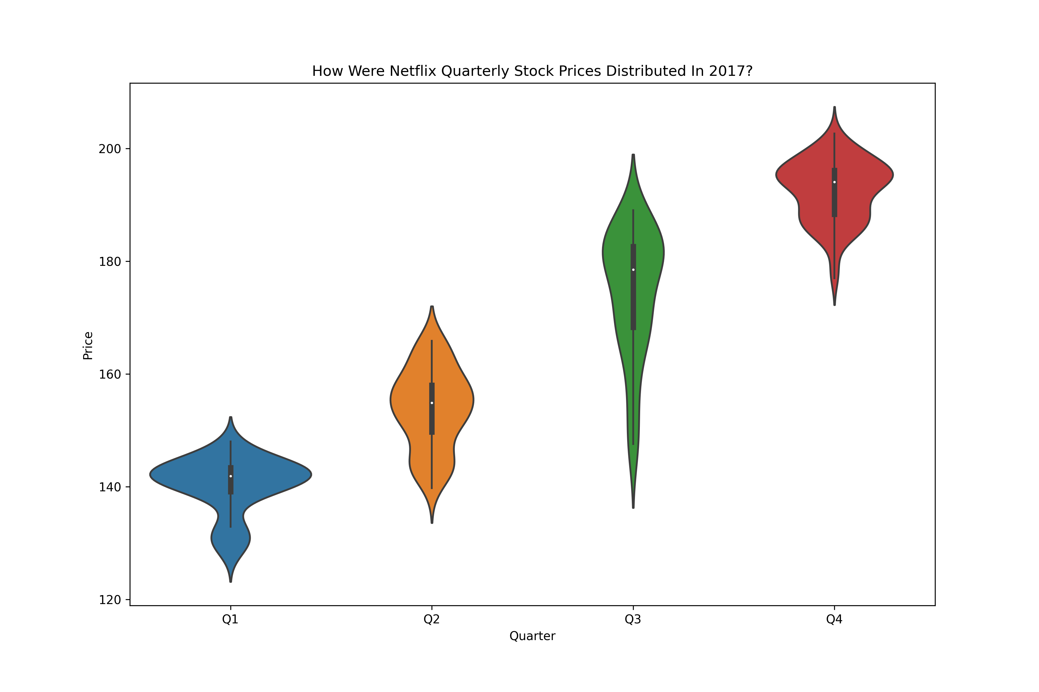

How Were Netflix Quarterly Stock Prices Distributed In 2017?
Netflix quarterly stock prices rose significantly over the year.
The third quarter reflects the largest range of stock prices.
Low prices were around $127 and high were around $202.

Slide 4
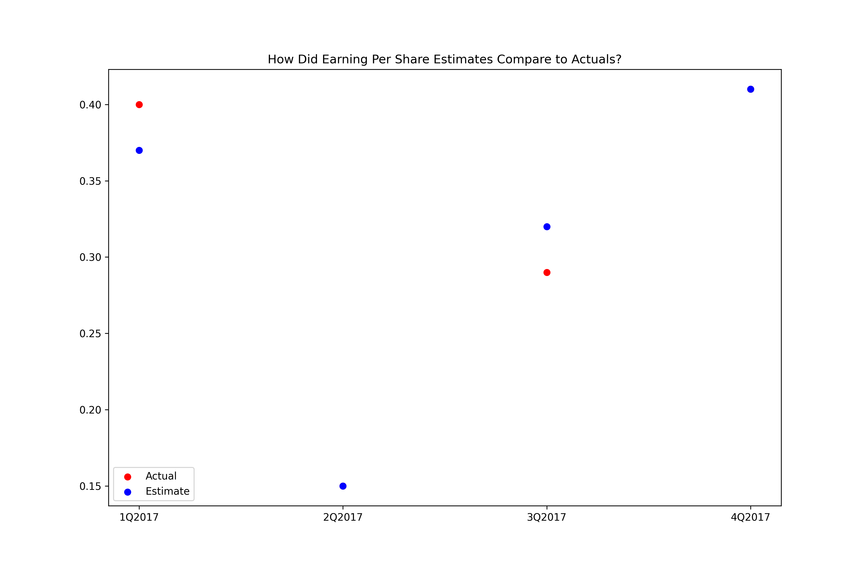
How Did Earning Per Share Estimates Compare to Actuals?
The purple dots represent the intersection of earning estimates with actual prices.

Slide 5
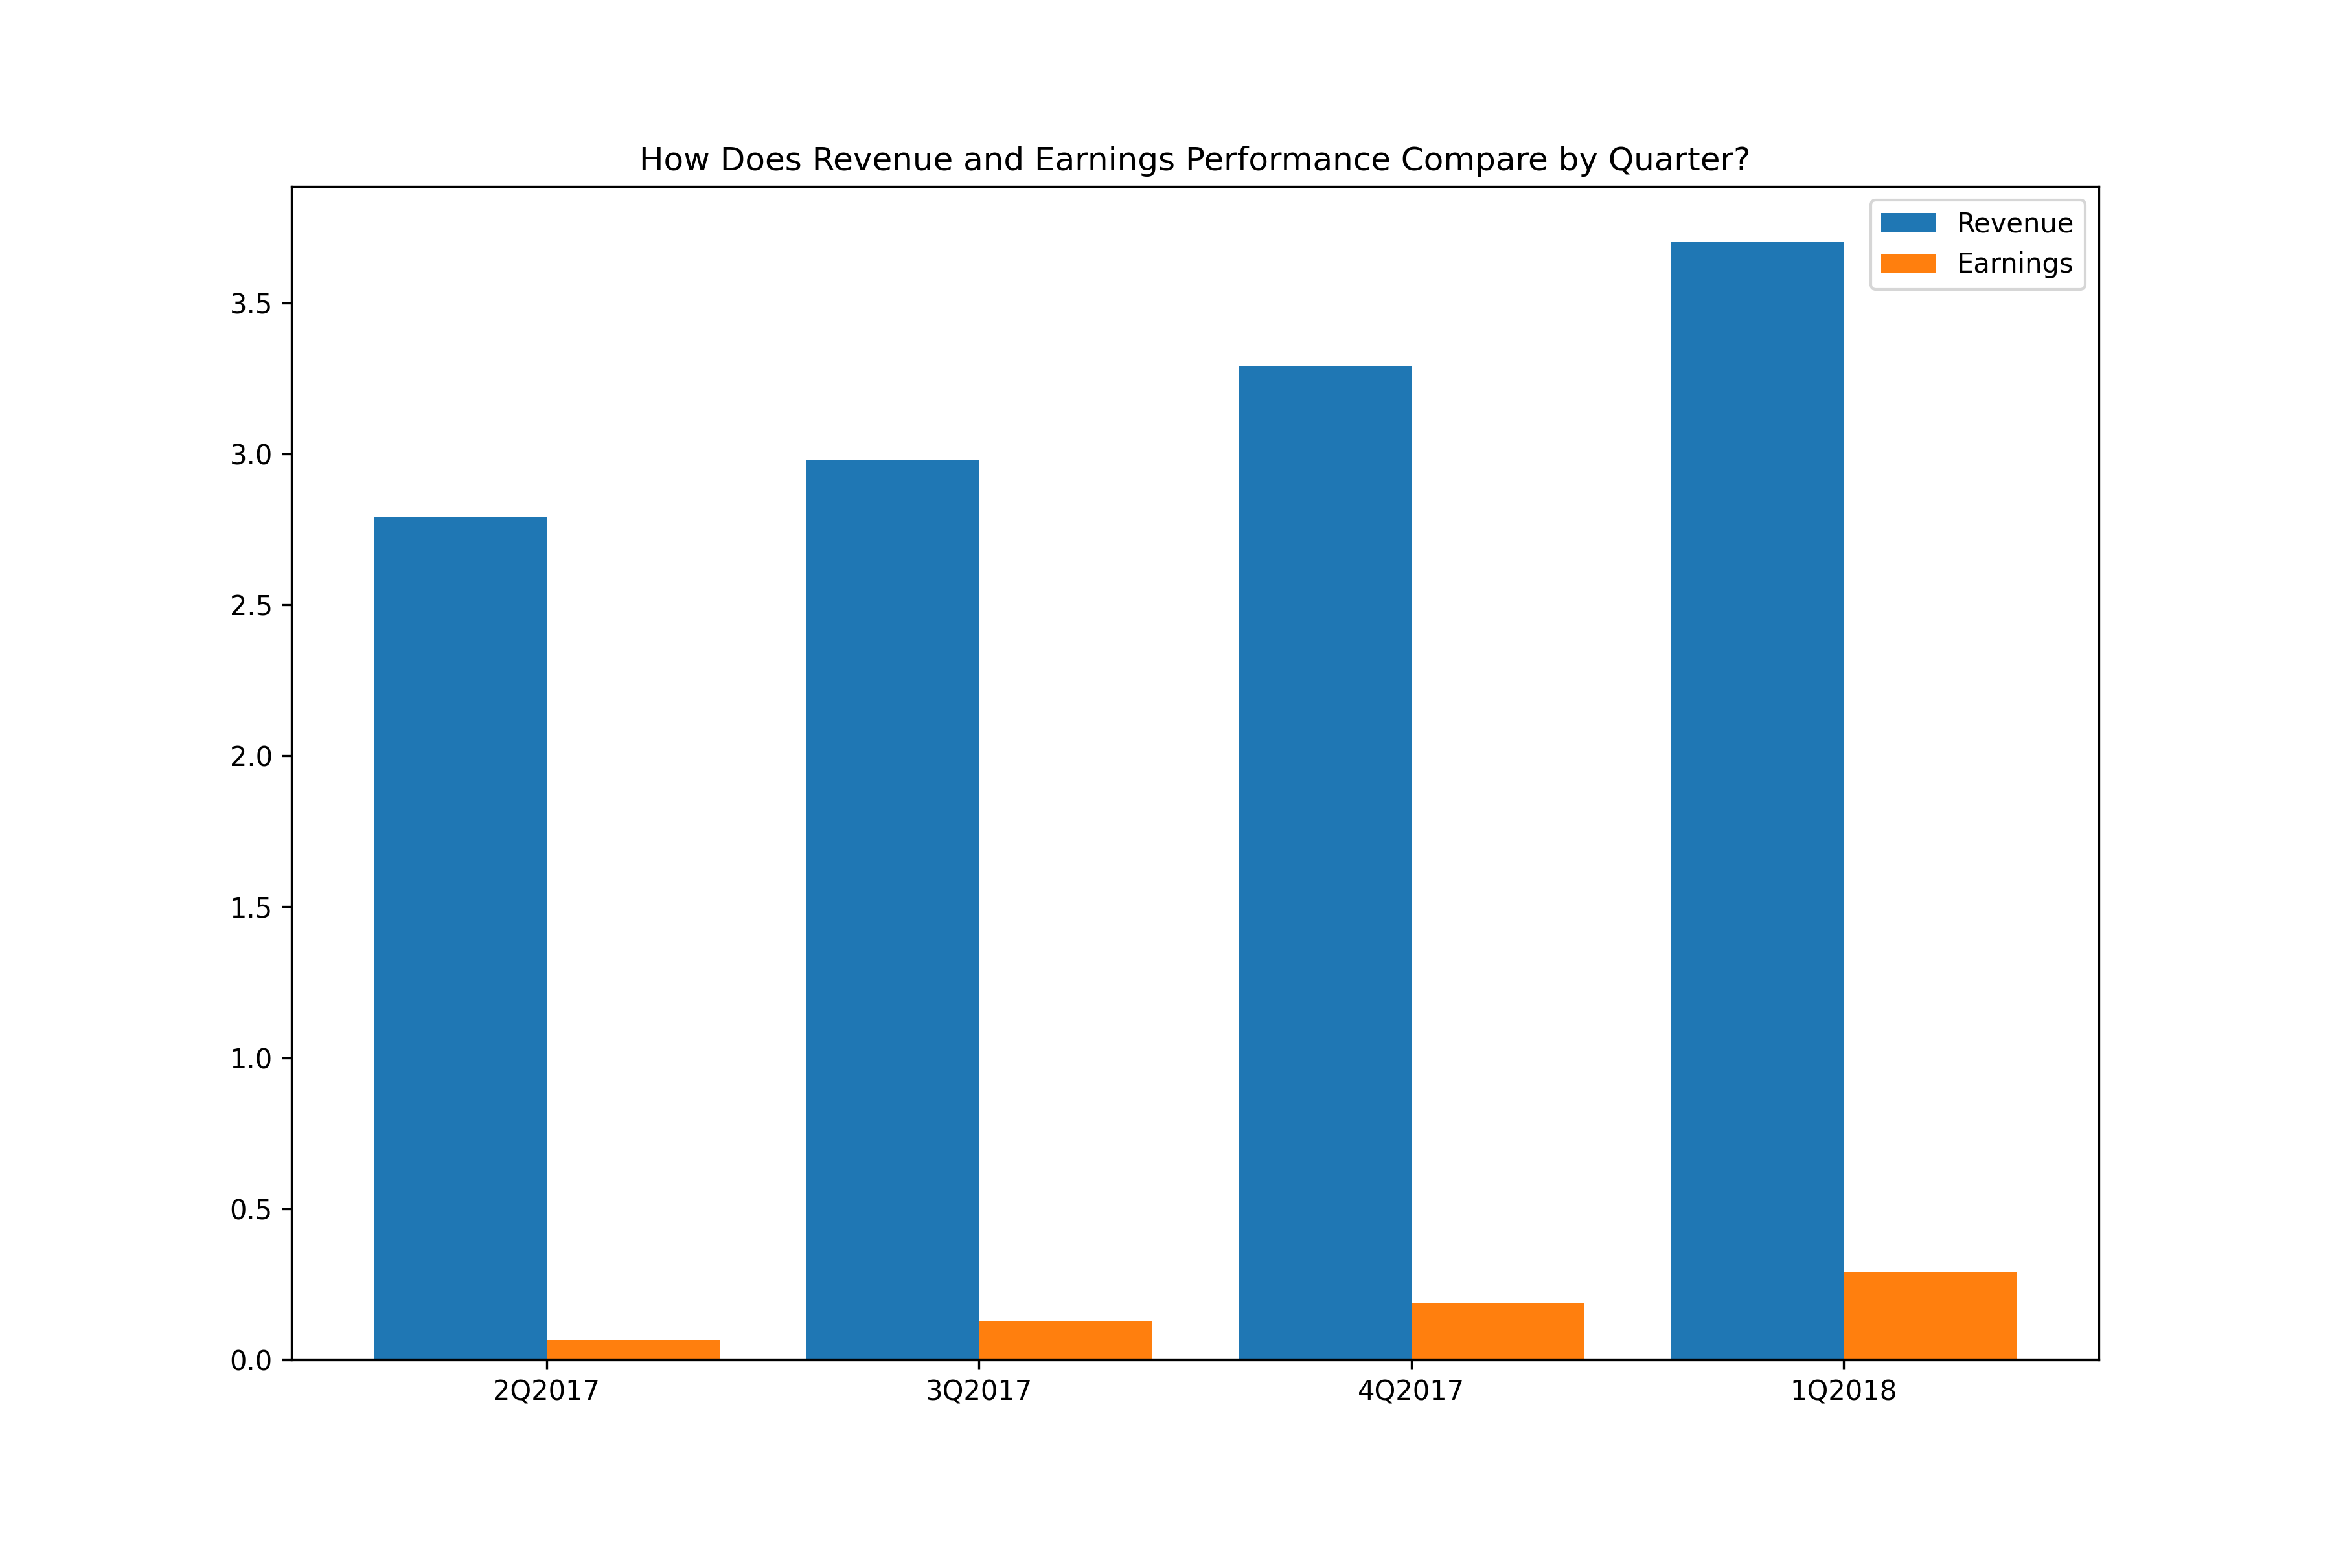
How Does Revenue and Earnings Performance Compare by Quarter?
Revenue and earnings are increasing each quarter.
Earnings is typically less than 10 percent of revenue each quarter.

Slide 6
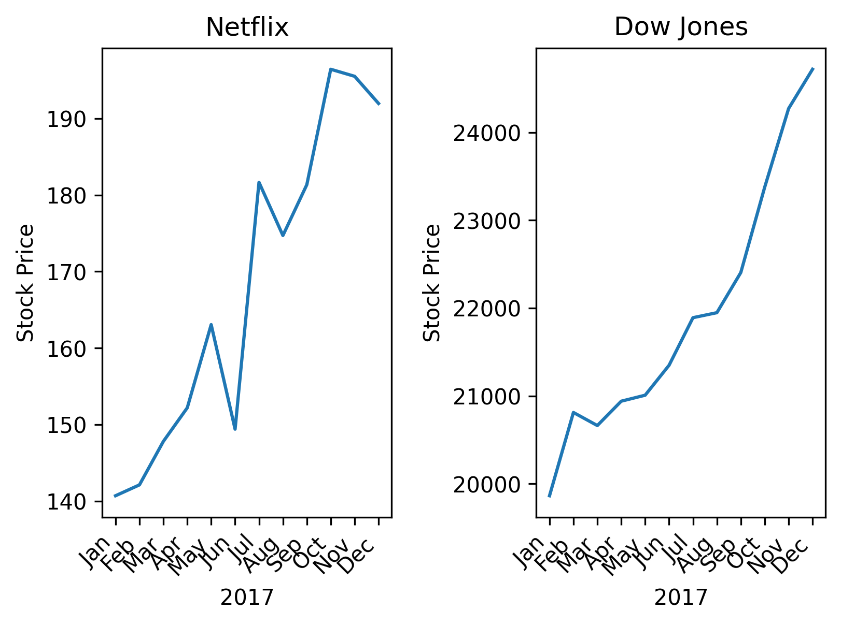
How Did Netflix Compare to the Dow Jones?
Netflix stock generally rose faster than the Dow in 2017.
Netflix, however, saw more correction than did the Dow.
Netflix was more volatile than the Dow.
Netflix stock differs from the Dow in that it is a single issue, and the Dow is an index, a portfolio of 30 stocks whose diversity smooths out the vicissitudes of the market.

Slide 7

Thank you
codingseptagenarian@gmail.com

